Slide 1

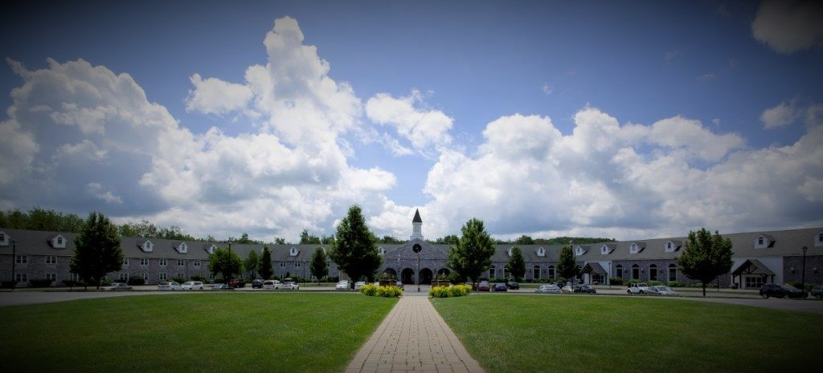
Make your
Prom Unforgettable
625 Betty Spring Road Gardner, MA
978-630-2500 www.colonial-hotel.com
find us on Facebook at Colonial Hotel* Gardner, MA

Slide 2
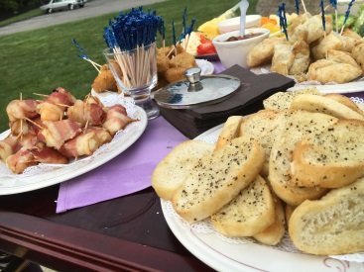
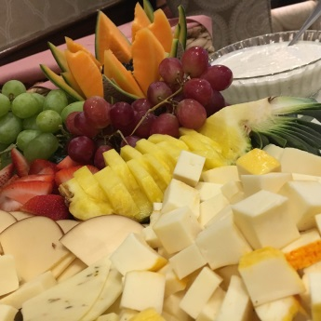
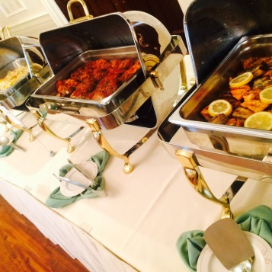
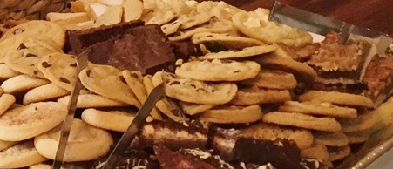
All packages include:
Chivari Chairs
White or Ivory Tablecloths
Choice of Napkin Color
Unlimited Soda
Plated Package $39
Mixed Garden Salad or Caesar Salad
Warm Rolls and Butter
(please select one of the following entrees)
Baked Stuffed Colonial Chicken, Chicken Parmesan (served with sides not pasta),
Maple Pecan Pork Loin, or London Broil
Chef’s Choice of Starch and Vegetables
Freshly Baked Cookies & Chocolate Lovers Cake
Buffet Package $39
Mixed Garden Salad, Caesar Salad or Tortellini Salad
Warm Rolls and Butter
Baked Stuffed Colonial Chicken or Chicken Broccoli Alfredo
Tenderloin Tips Diane or London Broil
Baked Macaroni & Cheese or Cheese Lasagna
Chef’s Choice of Starch and Vegetables
Freshly Baked Cookies & Chocolate Lovers Cake
Unless otherwise noted, all prices are per person.
All food and beverage prices are subject to change without notice.
All food and beverage prices are subject to a taxable 20% administrative fee and 6.25% MA State Tax. April 2023

Slide 3
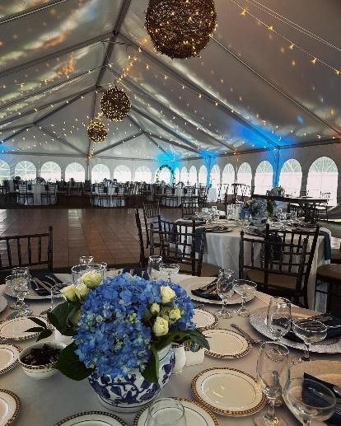
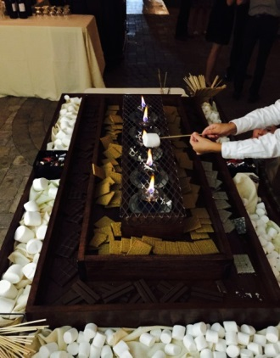
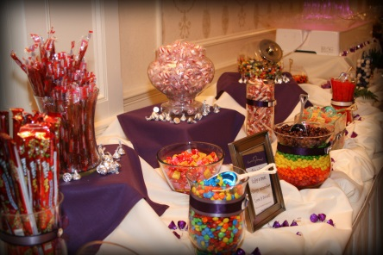
Enhancements To Dinner
All Stations are out for 1 hour
Mocktail Station- $15
(Choice of two)
Potato Skins, Chicken Tenderloins, Mozzarella Stick,
Or Assorted Pizzas
Candy Station- $10
Assortment of our favorite candies
S'more's Bar - $10
Marshmallows, Graham Crackers, Peanut Butter Cups,
White & Milk Chocolate Bars
Floor Length Tablecloths $10 per table White Ivory or Black
Centerpieces - $10+ per table
Unless otherwise noted, all prices are per person.
All food and beverage prices are subject to change without notice.
All food and beverage prices are subject to a taxable 20% administrative fee and 6.25% MA State Tax. April 2023

Slide 4
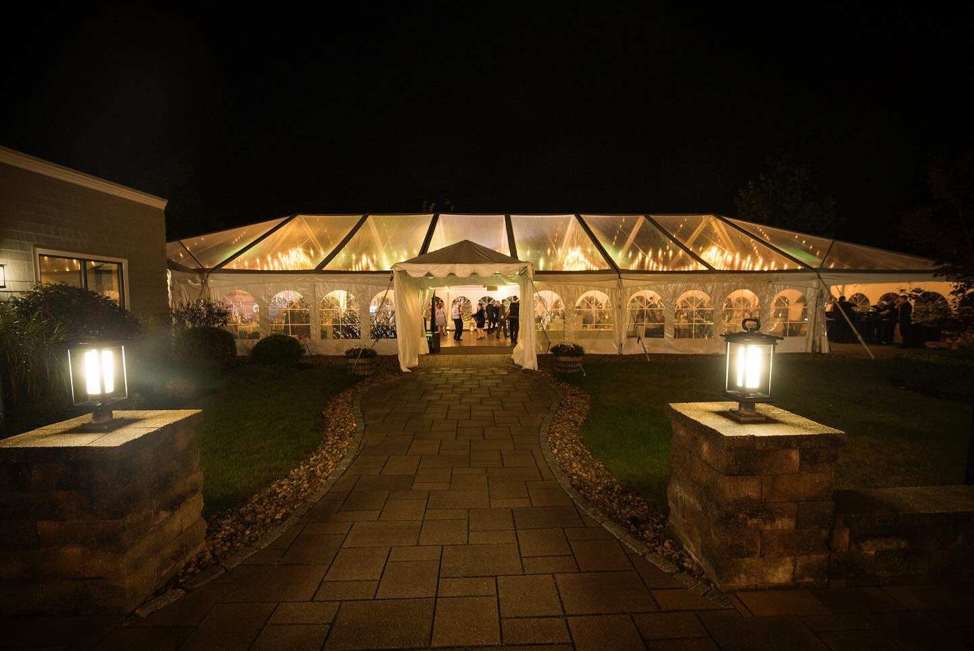
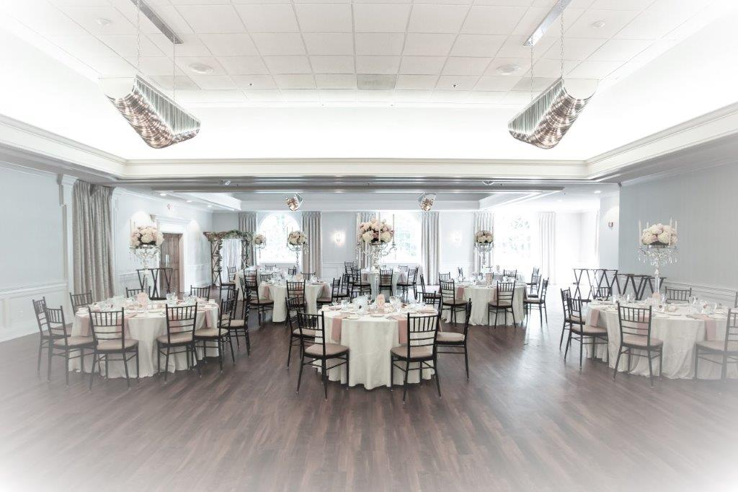
Two Great Locations to Choose From
Courtyard Tent
Grand Ballroom

