Slide 1

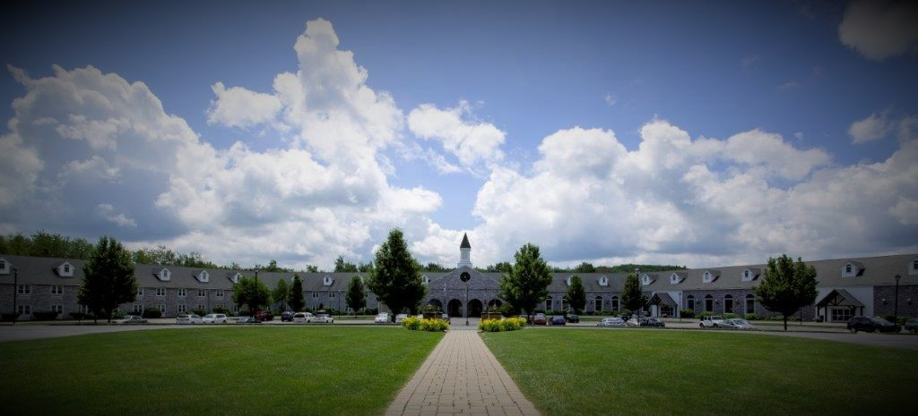
Make your
Prom Unforgettable
625 Betty Spring Road Gardner, MA
978-630-2500 www.colonial-hotel.com
find us on Facebook at Colonial Hotel* Gardner, MA

Slide 2
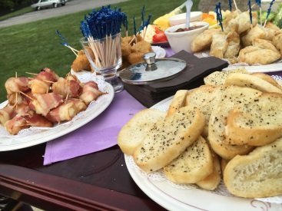
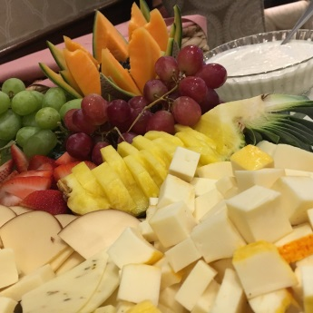
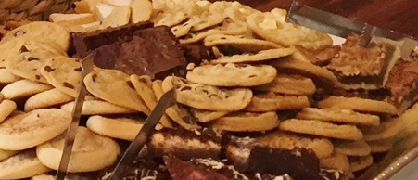
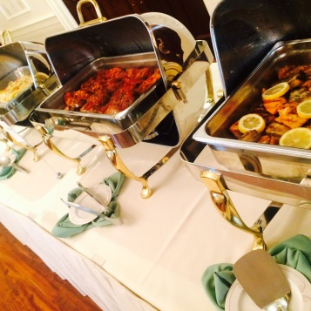
Package One $29
Cheese, Cracker & Fruit Display
Two Hours of endless hot butler passed hors d’ oeuvres
Golden Chicken Tenderloins, Breaded Mozzarella Sticks,
Broccoli/Cheddar/Ham Puffs and Fried Crab Rangoon's
Salad Station
Fresh Garden Salad with assortment of dressings
Caesar Salad with herb croutons
Bread Sticks
Freshly Baked Cookies
Package Two $32
Plated
Mixed Garden Salad or Caesar Salad
Warm Rolls and Butter
(please select one of the following entrees)
Baked Stuffed Colonial Chicken, Chicken Parmesan (served with sides not pasta),
Maple Pecan Pork Loin, or London Broil
Chef’s Choice of Starch and Vegetables
Freshly Baked Cookies & Chocolate Lovers Cake
Package Three $35
Buffet
Mixed Garden Salad or Caesar Salad
Warm Rolls and Butter
Baked Stuffed Colonial Chicken or Chicken Broccoli Alfredo
Tenderloin Tips Diane or London Broil
Baked Macaroni & Cheese or Cheese Lasagna
Chef’s Choice of Starch and Vegetables
Freshly Baked Cookies & Chocolate Lovers Cake
Other menus available upon request
Unless otherwise noted, all prices are per person.
All food and beverage prices are subject to change without notice.
All food and beverage prices are subject to a taxable 20% administrative fee and 6.25% MA State Tax.

Slide 3
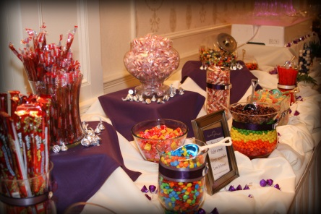
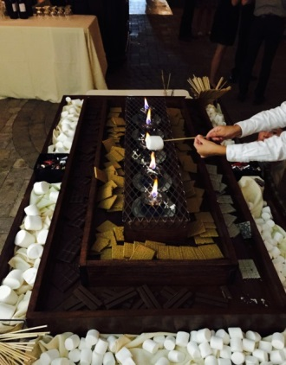
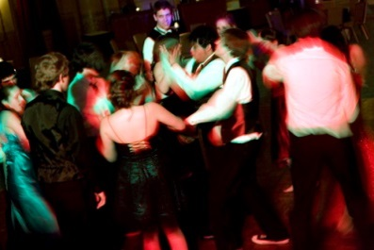
All packages include:
Chivari Chairs
White or Ivory Tablecloths
Choice of Napkin Color
Unlimited Soda During Dinner
Prom Package Enhancements
Mocktail Hour - $15
(choice of two)
Cheese and Cracker Display, Vegetable Crudité
Golden Chicken Tenderloin, Breaded Mozzarella Sticks,
Broccoli Cheddar & Ham Puffs, Crab Rangoon’s
Candy Station- $10
Assortment of our favorite candies
S'more's Bar - $10
Marshmallows, Graham Crackers, Peanut Butter Cups,
White & Milk Chocolate Bars
Late Night Station - $10
(Choice of two)
Potato Skins, Chicken Tenderloins, Mozzarella Stick,
Cheeseburger Sliders, Assorted Pizzas
Centerpieces - $10+ per table
Unless otherwise noted, all prices are per person.
All food and beverage prices are subject to change without notice.
All food and beverage prices are subject to a taxable 20% administrative fee and 6.25% MA State Tax.

Slide 4
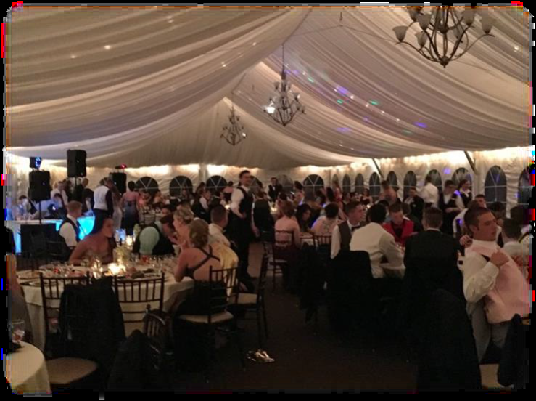
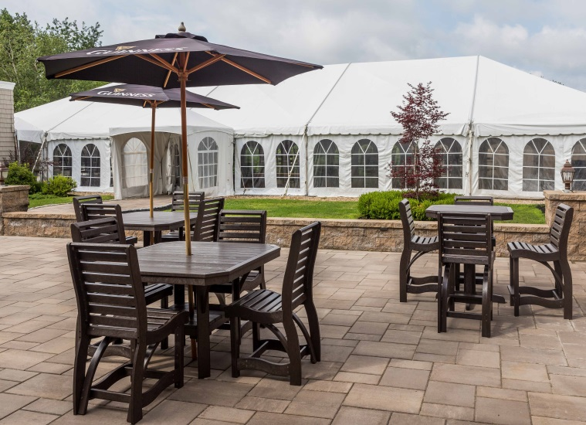
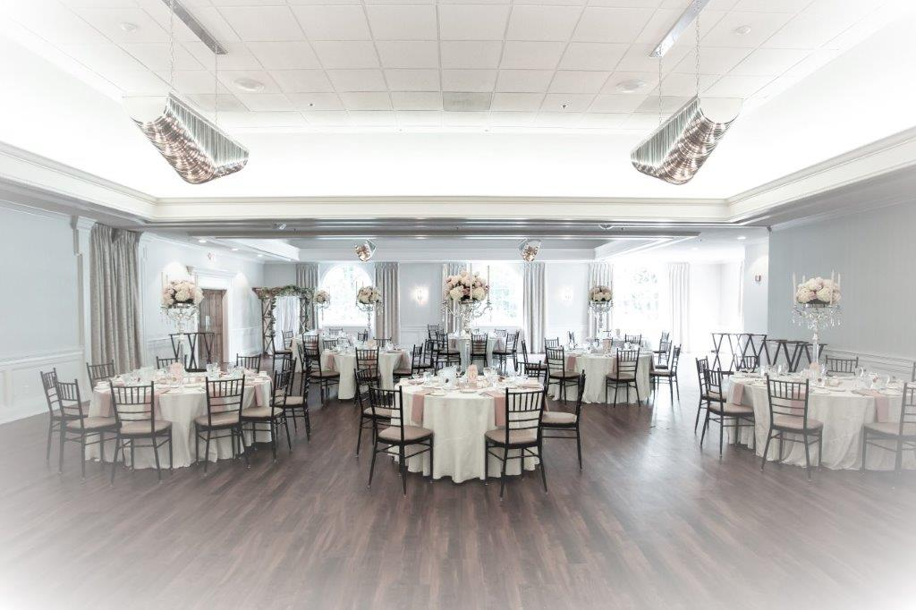
Two Great Locations to Choose From
Courtyard Tent
Grand Ballroom

